Slide 1

JOFFE EMERGENCY
SERVICES
Student and Family
Reunification

Slide 2

Welcome
About me
●
●
Dr. Matthew Colpitts and I am a Safety Consultant with Joffe Emergency Services.
Extensive background as a school leader and campus safety expert.
Goals
●
By the end of this module, participants will be able to…
○
○
○
1) identify the primary considerations in planning for reunification.
2) articulate the need for pre-incident reunification planning.
3) develop an outline of a new (or improved) reunification plan for their school.

Slide 3

Welcome
This module is actually the third in a trilogy.
●
The first module you may have completed is the Incident Command Orientation module, where you learned
what are the best practices to set up an ICS at your school and what roles and responsibilities your staff
should have during an incident.
●
●
Next, you may have completed the module of how to construct a Tabletop, where you learned how to lead a
practice run of an incident as it develops.
If you have not completed these modules, and feel that it would benefit you prior to starting this learning of
Student and Family Reunification, please complete the Incident Command Orientation module and the How
to Create and Run a Tabletop module before moving on with this course.

Slide 4

Definitions
Reunification is the process of
ensuring that children return to the
care of their parent(s) and legal
guardians as quickly and safely as
possible after an emergency.
Definitions
1) Reunification
2) EOP - Emergency Operations Plan
3) ICS - Incident Command System
4) FEMA - Federal Emergency
Management Administration
5) REMS - Readiness and Emergency
Management in School
(Based on https://www.cdc.gov/childrenindisasters/reunification.html)

Slide 5

Why Plan for
Reunification?
Why formalize it?
Isn’t it the same as dismissal?

Slide 6

High Stress and Anxiety Incidents
Maintain a safe environment and help reduce anxiety
A predetermined, practiced reunification method ensures the reunification process will not
further complicate what is probably a chaotic, anxiety-filled scene.
In fact, putting an orderly reunification plan into action will help defuse the emotions building up.

Slide 7
Scary Scenario to Avoid
Following a fire that left the school
building damaged, Tahir rushes to the
school to pick up his son.
When Shazeb arrives, she is unable to find
her daughter in the chaos that is the
basketball courts.
When he gets to the school, he sees
all of the children loosely assembled
on the basketball courts.
Staff are unsure if Shazeb’s daughter is still
on the courts.
Shazeb is understandably upset. It takes
several hours and a police search to figure
out what happened.
Tahir finds his son easily. Trying to be
helpful, he also takes takes his
neighbor Shazeb’s daughter.

Slide 8
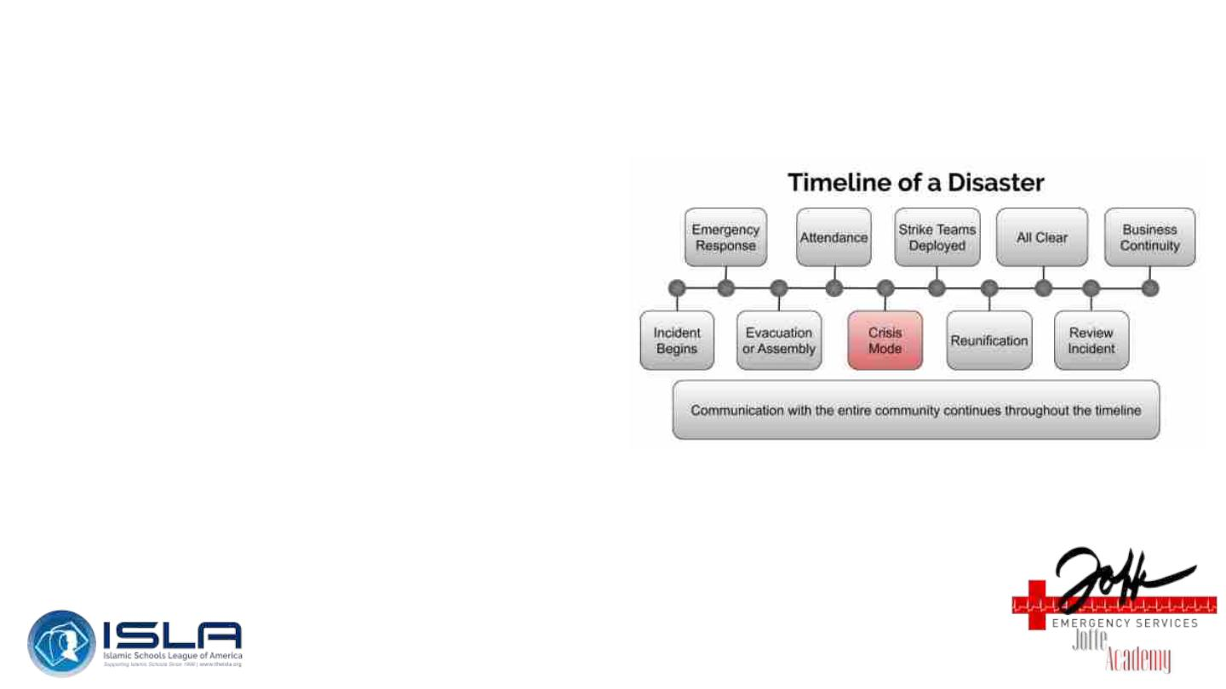
Reunification Rarely/Never Occurs on its Own
Part of other emergencies
Incident Command System (ICS) for your school is
activated. If not, do it now.
Disaster Timeline
1) We will almost always need other ICS teams
a) Search and Rescue
b) First Aid
c) Community Care
i) May need extended sheltering

Slide 9
Reunification Team
The reunification team seeks to:
1) Create an orderly process for
reuniting parents with children
2) Keep track of where students are
and with whom they left
THIS WILL BE HARD
In this course, we are focusing on the
administrative and tactical response
components of reunification but we must also
incorporate mental and emotional health
(community care) into this work.

Slide 10

How to Do It
Only happens when Incident Commander activates the process and reunification team
When Incident Command activates Reunification, personnel will be selected to oversee the process. Once
that happens, the Reunification supervisor will gather their team.
Together, they will start:
1) Begin setting up the Parent Check-in area and Final Check-out station.
2) Obtain necessary equipment and release forms.
3) Mark tables with signs so parents know where to check in, if possible.
4) Have Student Emergency Pickup Lists and Release Forms ready to go.

Slide 11

Basic Procedure
Once the process starts, the following basic procedure should be followed:
1) An adult checks in with the Reunification Staff and gives the name of the student(s) to be picked
up.
2) Staff member asks for an adult's identification to check against the student(s) Emergency
Card of individuals authorized to pick up. (DO THIS EVEN IF YOU KNOW THEM)
3) The staff member instructs the parent/guardian to standby while waiting.
4) When student(s) arrive at the reunification point, staff connect student(s) with parent/guardian.
a) Note: If a parent refuses to wait in line, don’t argue. Note the time with appropriate comments on
the student release form to have as much information taken down as possible.

Slide 12
Basic Procedure, Cont’d
If a student is not in the assembly area or is missing:
1) Communicate with the First Aid Team to determine if the student is in the Medical Treatment
area.
2) Determine if a student is able to be moved for reunification, if not: the parent/guardian should be
escorted to the Medical Treatment Area.
3) Determine if a student has been taken off campus by emergency medical personnel. If so, the
parent/guardian should be given the information about where the student was transferred.
4) If the student is “missing” - Communicate with Incident Command immediately
a) The parent/guardian should be notified of the missing student’s status and updated
regularly.

Slide 13
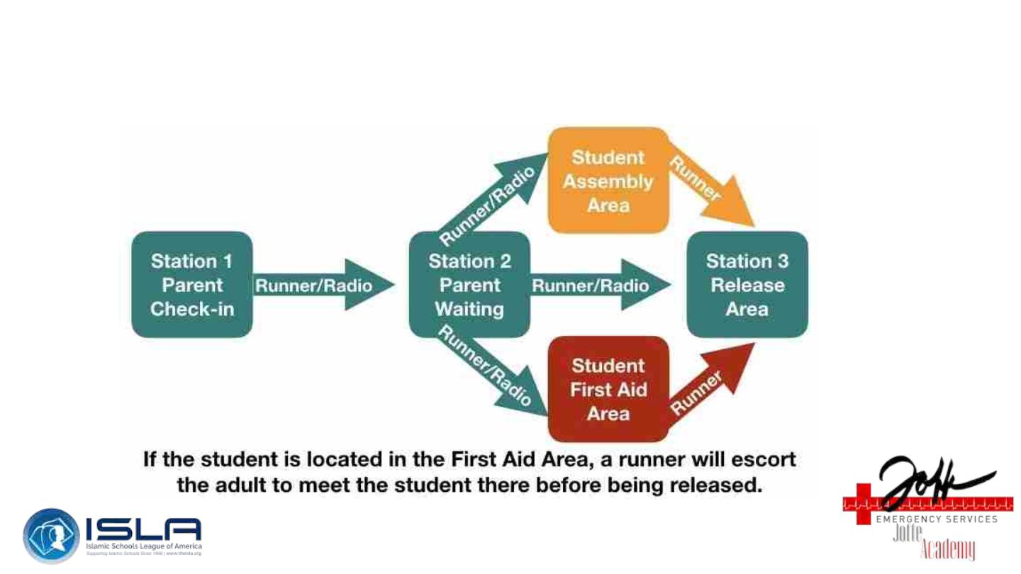
Flow of the Process

Slide 14
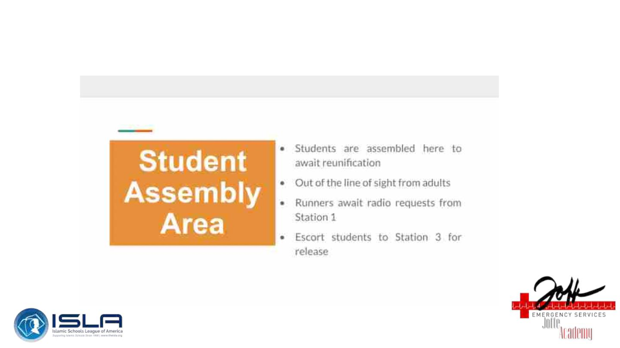
Student Assembly Area

Slide 15
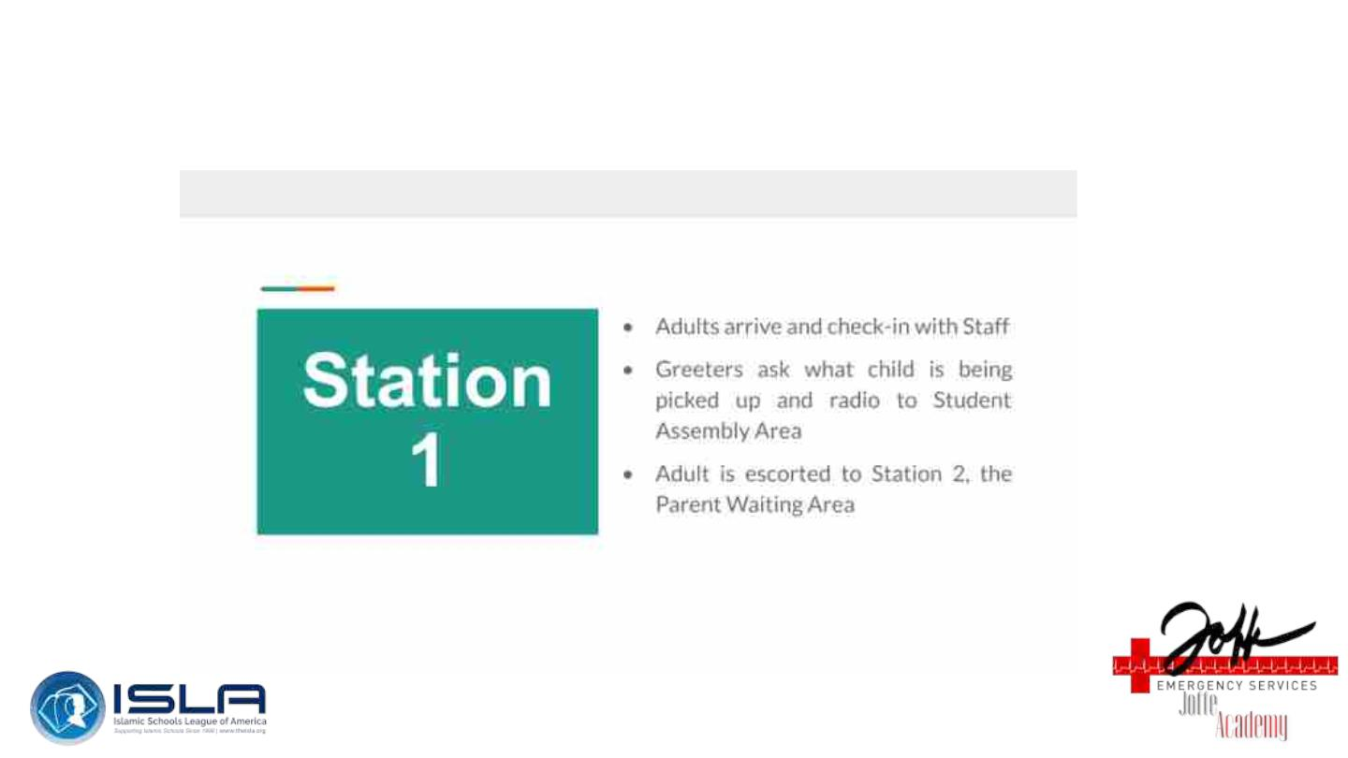
Station 1

Slide 16
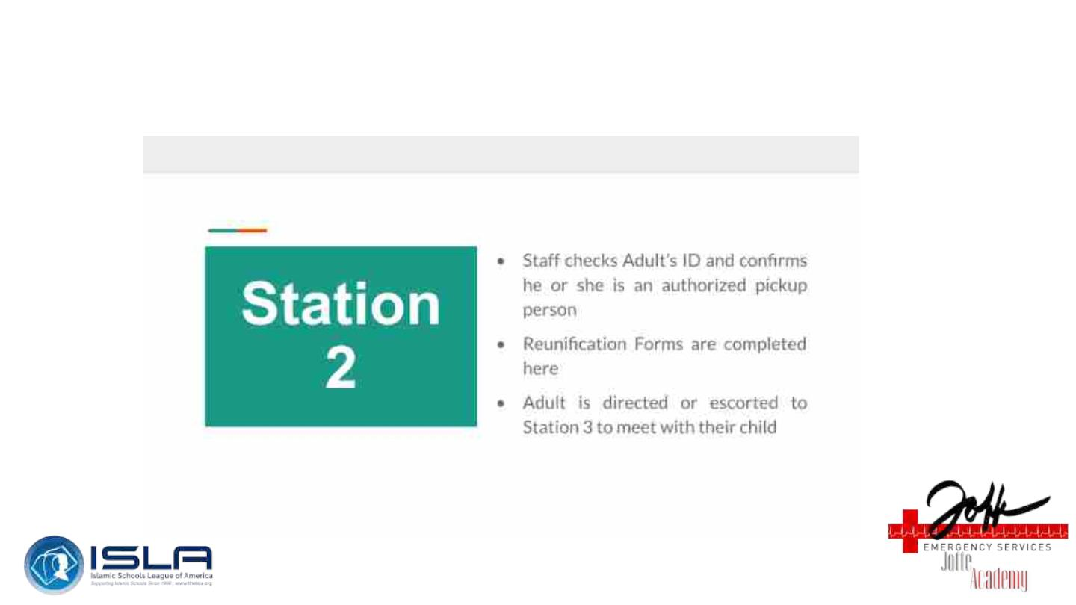
Station 2

Slide 17

Station 3

Slide 18

Levels/Types
Types
Levels
Permissions
●
●
At primary site
At secondary evacuation
location
●
Normal dismissal, just
early
●
●
●
●
Self Dismissal
High School Kids
Car Pools
●
●
Rapid Dismissal
Parents or Guardians
must come to take kids
ONLY legal parents and
guardians
●
Improvised Site
Restricted by School
●

Slide 19
Adults?
Students are the focus of this work but…
Remember, adults need to be accounted for as well!
1) Employees
2) Faculty
3) Staff
4) Guests
Do you have a system that is usable in an emergency that can account for these folks?

Slide 20
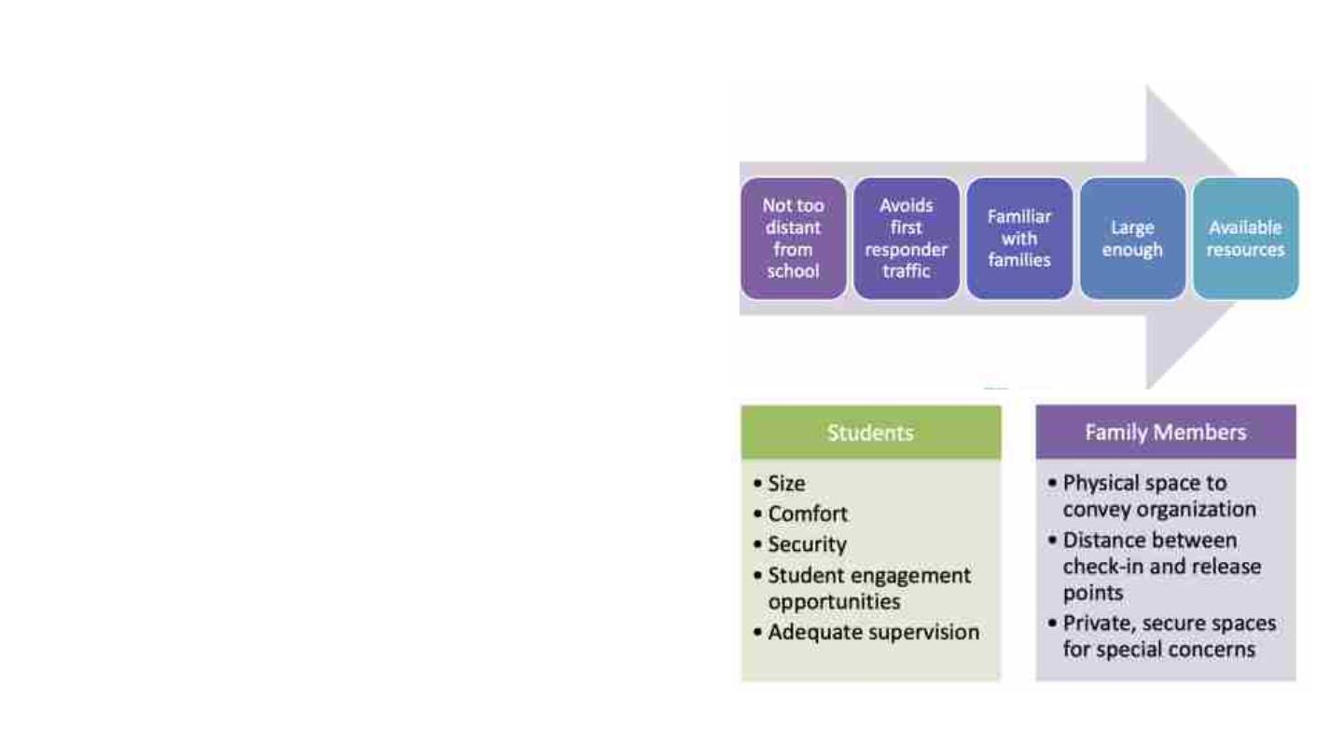
Emergency Operations Plan
Reunification & EOP
Reunification must be a part
of your school emergency
operations plan.
Either in the core part or in
an annex.
Location
Location Selection is Critical
https://rems.ed.gov/

Slide 21

Emergency Operations Plan
Planning Considerations
Your Community Needs
Informing families
Special considerations for your
school and population
●
●
●
Ahead of time
At time of incident
Ongoing
●
●
●
Medical
Disabilities
Functional Needs
How to verify
custody/permission
Communication at
Reunification Site
Managing the Media
No leaving on own
Addressing barriers

Slide 22
Challenges
High Stress and Anxiety
●
●
NOT A TIMED EVENT
USE ICS
Keep parents away from students
Make sure parents know about the process ahead of time
●
○
○
Practice, practice, practice
Be firm, calm, and consistent
Non-custodial parent tried to pick up child
●
●
●
Do not let them unless you have explicit permission from custodial parent
Follow any policies you have in place for dismissal
Contact custodial parent and police if necessary
○
Contact principal/incident command for advice

Slide 23

Challenges
Maybe, not everyone will make it
1) Sent to the hospital
2) Stuck on site
3) Missing
4) Entrapped
5) Dead
***When reunification is not possible because a child is missing, injured, or killed, how and when
this information is provided to families is critical.***
Before an emergency, the planning team must determine how, when, and by whom loved ones will be
informed if their loved one is missing or has been injured or killed.
While law enforcement and medical examiner procedures must be followed, families should receive
accurate information as soon as possible. Having trained personnel immediately available to talk to
loved ones about death and injury can ensure that families receive accurate and timely
information in a compassionate manner.

Slide 24
Supplies, Communication, & Relationships
What is needed for a reunification site?
1) What is the number one thing?
a) Rosters and information…
2) Attendance Process and Rosters
a) Electronic
Communication
1) Emergency Notification Systems
a) Phones
b) Radios
c) Runners
b) Paper
i) Alpha (all school)
Mutual Aid and Relationships
1) Agreements
a) Mosque
ii) By homeroom/advisory
iii) Per Period - Teacher class
rosters (optional)
b) Neighbors
c) Update once per term (or just after
your major enrollment periods)
3) Other Emergency Supplies
c) Police
d) Other Islamic Organizations
e) Joffe

Slide 25

Conclusion
Once this video concludes, you will be provided the module handout offering a checklist of the actions that should be taken during
the reunification process. Feel free to use this handout as you complete the post-module survey as well.
This module acts as the conclusion in a trilogy of modules:
●
●
●
Incident Command Orientation
How to Create and Run a Tabletop
Student and Family Reunification.
If you have not completed any of the previous modules, I encourage you to do so as they are great resources and offer
preparedness and peace of mind for a school.

Slide 26

We are here to help
Joffe Emergency services also offers schools safety assessments
and consultative services to coach, guide, train, and support your
school through every stage of an emergency.
If you would like to schedule a call, please visit our website
at joffeemergencyservices.com.
Thank you for participating in this Joffe Academy module with
Joffe Emergency Services.

Slide 27
Resources
●
●
●
●
https://www.ready.gov/sites/default/files/2019-06/post_disaster_reunification_of_children.pdf
https://rems.ed.gov/docs/Post-Disaster_Reunification_Fact_Sheet_for_compliance_508C.pdf
https://www.cdc.gov/childrenindisasters/reunification.html
Joffe Resource - Student Attendance & Reunification Strike Team Checklist

