Slide 1
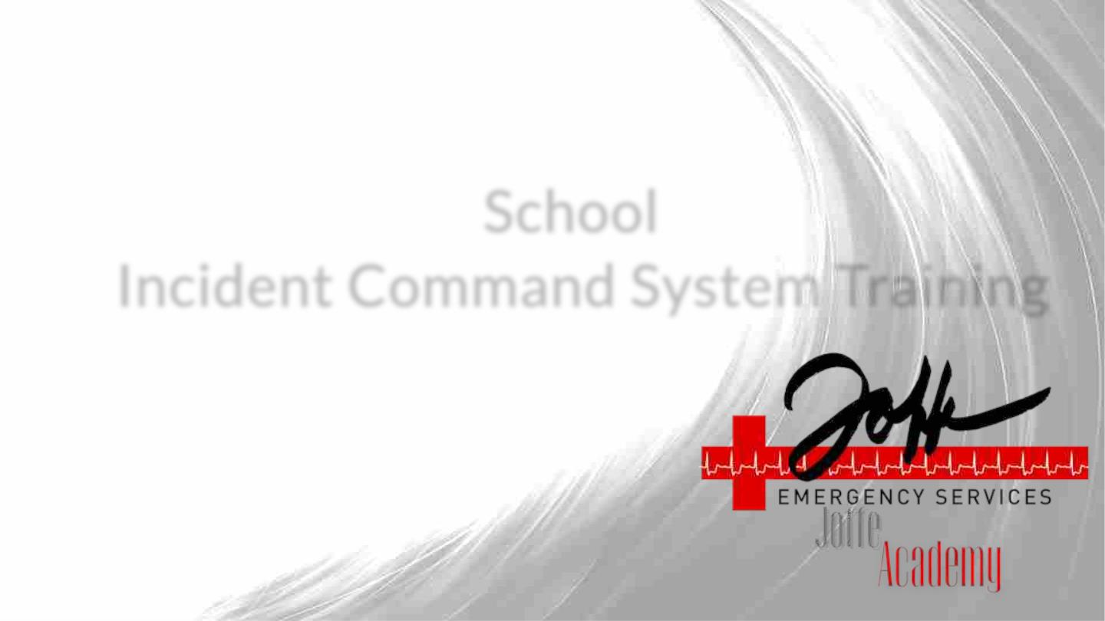
School
Incident Command System Training

Slide 2

Objectives
By the end of this module, participants will be able to:
1. Define an Incident Command System
2. Identify the purpose of an ICS on their campus
3. Identify what ICS roles their school needs to best manage a crisis

Slide 3

Framing
● When an emergency strikes, there is the potential for mass
chaos
● Schools can alleviate this when there is an Incident Command
System in place
● Each staff member knows their role, responsibility, and who
to look to for guidance

Slide 4
Incident Command System
● Incident Command System Overview
● ICS Roles & Responsibilities
○ Command Staff
○ School Strike Teams
● Next Steps After ICS

Slide 5
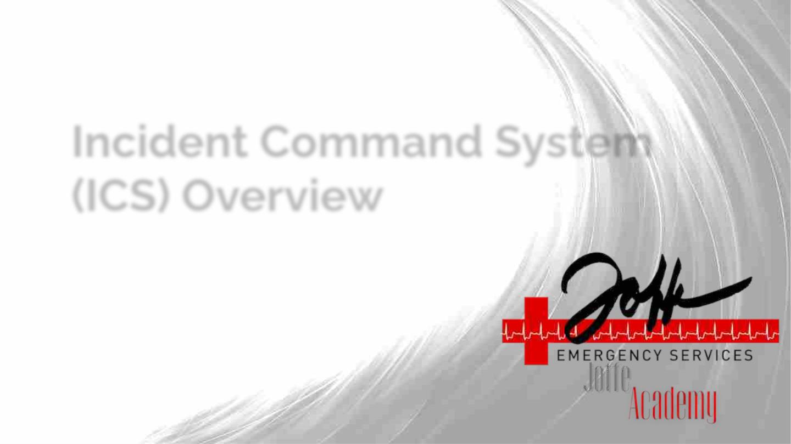
Incident Command System
(ICS) Overview

Slide 6

What Is The Incident Command System (ICS
➔ A management system
➔ A flexible tool
◆ Adaptable to the details of
◆ Facilitates effective
response
your community, whether
big or small
◆ Establishes common
organizational
structure
◆
Depending on the crisis, we
may use part or all of the
ICS structure
➔ A set of terminology
◆ Defines are how teams are organized, function, and communicate
◆ Used and understood by Fire, Police, EMS and other agencies nationally

Slide 7

Why does this matter for us?
Purpose:
● Set priorities for an incident. Clearly designate roles and responsibilities
that can be deployed in any sized incident.
Planning:
● Pre-assign specific individuals, based on experience, role, and skills.
Practice:
● Use drills and tabletops to identify strengths and gaps before an incident
occurs and build confidence among team members.

Slide 8

Incident Command System Features - Top 3
Unity and Chain of Command
● Each person reports to one supervisor; clear line of
authority and clarity of leadership
● Note: This may not be your day-to-day supervisor
Span of Control
● Key for effective management
● Supervise 3-7 people; ideally no more than 5
Common Terminology
● Helps to define organizational functions, incident
facilities, resource descriptions, and position titles;
provides clarity across agencies and jurisdictions

Slide 9
The “First On” Model and the Role of an Incident Commander
● The first person to engage (on the scene / in the loop) is “in charge” until
someone more senior or with a higher level of training takes over.
● The Incident Commander is the person responsible for all aspects of an
emergency response; including quickly developing incident objectives,
managing all incident operations, application of resources as well as
responsibility for all persons involved.

Slide 10
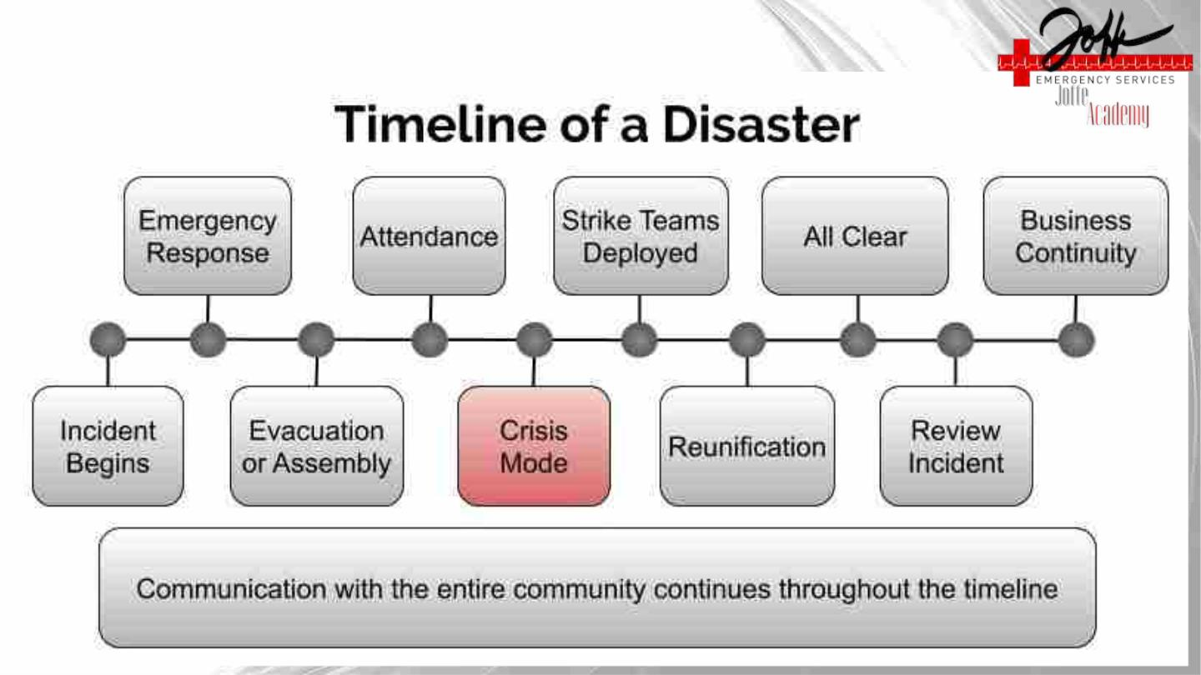

Slide 11
Crisis Mode
● When an emergency takes place, evacuate and stay with your students
in the assembly area
● Strike Teams do not assemble until Incident Command initiates “Crisis
Mode”
● Once Crisis Mode is called:
○ Notify District office through the School Liaison
○ Assemble with your Strike Team, leaving students under care of
Student Support
○ Team Leaders inform Incident Command that your team is
assembled and notify IC if anyone on the team is missing
○ Once given instruction from Incident Command, start your Strike
Team function

Slide 12
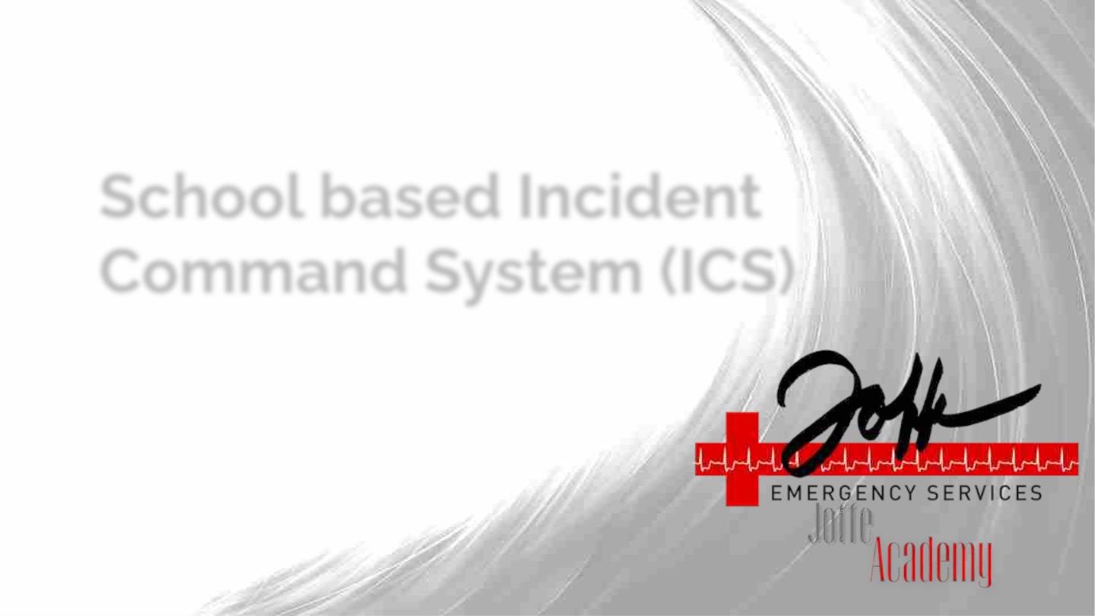
School based Incident
Command System (ICS)

Slide 13
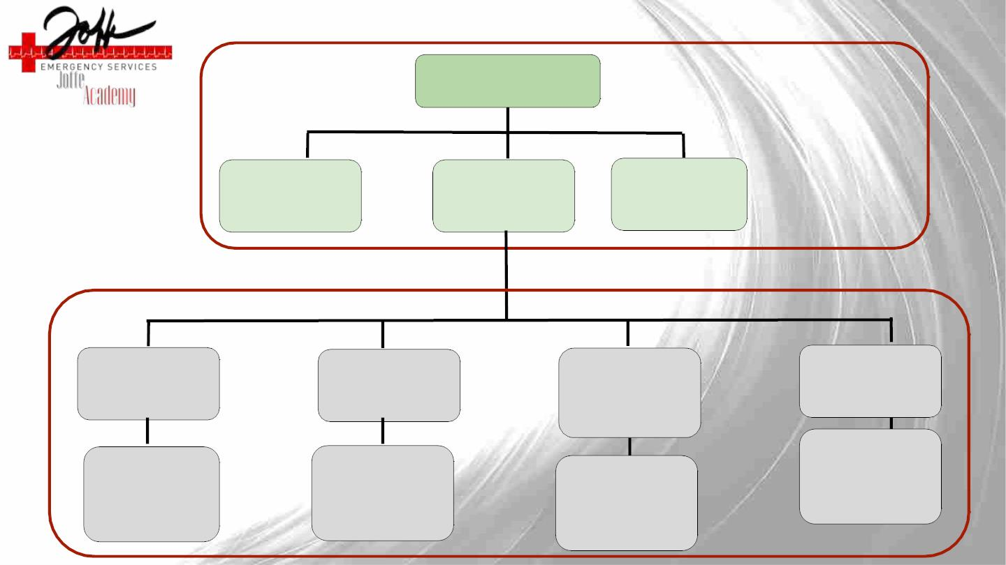
INCIDENTꢀCOMMANDER
COMMAND STAFF
Name
Name
COMMUNICATIONSꢀ
LIAISONꢀ
SAFETYꢀꢀ
DIRECTOR
Name
Facilitiesꢀ&ꢀ
Logistics
Name
Name
Name
Name
Name
STRIKE TEAMS
SEARCHꢀ&ꢀRESCUE
FIRSTꢀAIDꢀ&ꢀ
TRIAGE
Name
ASSEMBLYꢀ&ꢀ
CRISISꢀ
COUNSELING
Name
Name
Name
ATTENDANCE,ꢀ
REUNIFICATION
Name
Name
Name
Name
TeamꢀMembers
Name
TeamꢀMembers
Name
TeamꢀMembers
Name
TeamꢀMembers
Name
Name
Name
Name
Name
Name
Name
Name
Name
Name
Name
Name
Name

Slide 14

School Based Incident Command
System (ICS)
Roles & Responsibilities

Slide 15

Command Staff

Slide 16

School Incident Commander
For every incident it needs to be clear who is in charge. In the ICS, that
person is the Incident Commander. The Incident Commander:
● Establishes objectives, makes assignments,
activates teams, and orders/deploys resources.
● Works closely with staff and technical experts to
analyze the situation and determine strategies.
● Should have training, experience, and expertise
to serve in this capacity.
● Oversees Safety/Logistics, Communications,
Situation Analysis, Attendance/Reunification,
and Community Care Directors

Slide 17
School Incident Commander Guidelines
➢ Take command.
➢ Establish incident objectives.
➢ Perform ongoing risk assessments to balance response initiatives with
safety concerns.
➢ Motivate responders.
➢ Communicate clear directions and ensure directions are understood.
➢ Delegate responsibilities to the leadership team as necessary.
➢ Activate Strike Teams as needed.
➢ Size up the situation and make rapid decisions.
➢ Assess the effectiveness of tactics and strategies.
➢ Be flexible and modify plans as needed.

Slide 18

Communications Liaison
● Reports to the School Incident Commander
● Responsible for collection, evaluation,
dissemination, and use of information about
development of incident, status of resources, and
demobilization of the incident for the purposes of
external communications

Slide 19
Communications Liaison
➢ Liaison between District Communications Officer and school-as it relates to
family and faculty & staff communications before, during, and after incident
➢ Drafts and sends phone calls/texts/emails to necessary family, faculty, and staff
with the support from District Communications Officer
➢ Updates Command Team on what communications have been sent, to share with
students / faculty / staff as appropriate
➢ This may include drafting and sending phone calls/texts/emails as well as updating
the school website and other social media.

Slide 20

Safety Director
● Reports to the School Incident Commander
● Directing the management of all tactical activities
on behalf of the Incident Commander
● Organizes, assigns, and supervises the tactical
response and operations of the following Strike
Teams:
○ Search & Rescue
○ First Aid & Triage
○ Assembly, Attendance & Reunification
○ Crisis Counseling

Slide 21
Safety Director Guidelines
➢ Activate Strike Teams as appropriate and required for the incident.
➢ Facilitate coordination between Strike Teams as needed.
➢ Identify and mitigate safety hazards and situations. Stop or modify all
unsafe operations.
➢ Ensure that responders use appropriate safety equipment.
➢ Think ahead and anticipate situations and problems before they may occur.
➢ Anticipate situation changes, such as cascading events, in all planning.
➢ Keep Incident Command advised of your status and activity and on any
problem areas that need immediate or future solutions.

Slide 22

Facilities & Logistics
●
This role generally supports the logistical needs of the
other teams
○
Assist with the distribution, inventory, and
tracking of long term care supplies (food, water,
sanitation, shelter)
●
Assesses building stability and viability after a major
event
●
●
Handles gas, power, and water shutoffs
May pull in maintenance personnel to support with this

Slide 23

Facilities & Logistics: Best Practices
➢ Assemble at designated area and confirm assignments amongst team
➢ Don appropriate personal protective gear and identifiers
➢ Assess building and structures for damage
➢ Mark unsafe areas with signage or caution tape
➢ Shut off gas, water, and electricity as needed
➢ Gather and distribute supplies as needed
○ Emergency Supplies: Communication, Search and Rescue, First
Aid & Triage
○ Additional Supplies: Food, Water, Shelter, Sanitation
➢ Track consumable items for individual allotment and restocking after
the event. Manage consumption according to team leader instructions

Slide 24

School Strike Teams

Slide 25

Search & Rescue
● Reports to Safety Director
● Search & Rescue team is responsible for light
search and rescue in lieu of first responders
● Enter*** and search the building to find anyone
who has not made it to safety
● Help with extrication of the trapped / injured
● Liaise with the First Aid Team to ensure
adequate treatment
● Next Steps: Decide where your meeting point
will be?
***DO NOT ENTER A DANGEROUS ENVIRONMENT***
***DO NOT PERFORM SEARCH AND RESCUE BY YOURSELF***

Slide 26
Search & Rescue: Best Practices
➢ Assemble everyone at the designated area
➢ Confirm section assignments amongst team members; assign ‘buddies’
➢ Don appropriate personal protective gear and identifiers
➢ Gather supplies and equipment
○ Hard hats
○ Goggles
○ Dust Masks
○ Powerful flashlight
○ Tape
○ Crow bar or other tools
○ Chalk/markers/paint
○ Cribbing
○ Radios
➢ Working in groups of two or more, sweep building, and get everyone out
○ Mark room with an X as you sweep
➢ Communicate with Team Leader early and often
➢ Always maintain contact with search partners
➢ Take injured to First Aid

Slide 27

First Aid & Triage
● Reports to Safety Director
● Responsible for triaging patients according to
severity of injury as they arrive in the First
Aid Area.
● Provide First Aid to students, staff, and
faculty during the initial response and
throughout incident
○ Stabilize anyone with major injuries
until arrival of EMS
○ Treat anyone with minor injuries
***Do not provide any treatment that
you are not trained to perform
and/or don’t feel comfortable
doing***
● Properly release patients to appropriate
transport units
● Next Steps: Decide where your meeting
point will be?

Slide 28
First Aid & Triage: Best Practices
➢ Assemble everyone at the designated area
➢ Confirm assignments amongst team members
➢ Don appropriate personal protective gear and identifiers
➢ Gather supplies and equipment
○ First Aid Kits including: bandages, gauze, gauze rolls, tape, etc.
○ Triage: tags, colored tape and/or tarps
○ Clipboards, pens, paper and/or forms
➢ Triage everyone before you treat anyone
➢ Stabilize serious patients first; then treat other urgent/delayed injuries
➢ Track patients’ information using appropriate forms
➢ Team Leader should communicate with Incident Command and EMS
➢ Coordinate with Search and Rescue as appropriate

Slide 29

Attendance, Assembly & Reunification
● Reports to Safety Director
● The team will facilitate the taking of attendance of students
and adults at the evacuation meeting point.
○ Know who has made it to the evacuation or assembly
point and who is unaccounted for
○ Assist teachers in keeping students calm and engaged
○ Track students throughout the lifecycle of the
emergency (this may mean taking attendance multiple
times)
○ Make sure no students leave the designated area until
reunification has been initiated

Slide 30

Attendance, Assembly & Reunification
● This team is also responsible for helping
parents reunite with their children in the
aftermath of an emergency.
● Accountability is the #1 priority during
Reunification. Speed is not important here.
● Responsible for accounting for every
student released, and accurately document
their release time, adult, and destination.
● Keep adults and students separate until
they are ready to leave.

Slide 31
Attendance, Assembly & Reunification: Best
Practices
➢ Team leader will take team attendance and assign roles
➢ Confirm roles amongst team members
➢ Gather supplies and equipment
○ Current rosters for students & staff
○ Early release list, absent list, visitor list
○ Clipboards and pens
➢ Take attendance of everyone you are responsible for, compare this to known list
➢ Report to the next level up
➢ Be ready to take attendance multiple times throughout the event
➢ Monitor students during the event, making sure to engage them, keeping them
calm and quiet throughout, and update them on the school’s communication
with parents
➢ Continue to report any incidents throughout the event to the next level up

Slide 32
Reunification: Best Practices
➢ Assemble everyone at the designated area
➢ Confirm assignments amongst team members
➢ Don appropriate personal identifiers
➢ Set-up Stations 1, 2, and 3 with tables, chairs, and signage if available
➢ Gather supplies and equipment
○ Phone with camera
○ Reunification Forms
○ Clipboards and pens
➢ Communicate to Student Assembly which children are being picked up
➢ Verify identification of the adult who is picking up the student
➢ Escort adults and students to and from appropriate areas
➢ Final check off performed at the student release area
➢ Potentially help in parent waiting area or student relief area

Slide 33
Crisis Counseling
●
●
●
●
●
●
This team monitors and supports the emotional and mental well being of students and staff.
Assist in maintaining overall morale of the group
Offer comfort items like food, a blanket, or a toy
Engage students in activities or with entertainment
Create peer to peer counseling spaces
May pull in part time staff if available on site that day

Slide 34
Crisis Counseling: Best Practices
➢ Don identifiers, if applicable
➢ Gather supplies and equipment
○ Food and water
○ Clipboards, paper, pens
○ Games, books, or other activities
➢ Work with First Aid and Attendance to identify individuals in need of
support
➢ Be mindful of students who are particularly anxious
○ Comfort and counsel them as appropriate and able
○ Provide private space for counseling as necessary
➢ Provide engagement and entertainment to students as a whole

Slide 35
Next Steps
➢ Visit “How to Run a Tabletop” & “Family Reunification After an Incident”
modules in Joffe Academy
➢ Check out School Safety Assessments & Consultative Services at
www.joffeemergencyservices.com

Slide 36
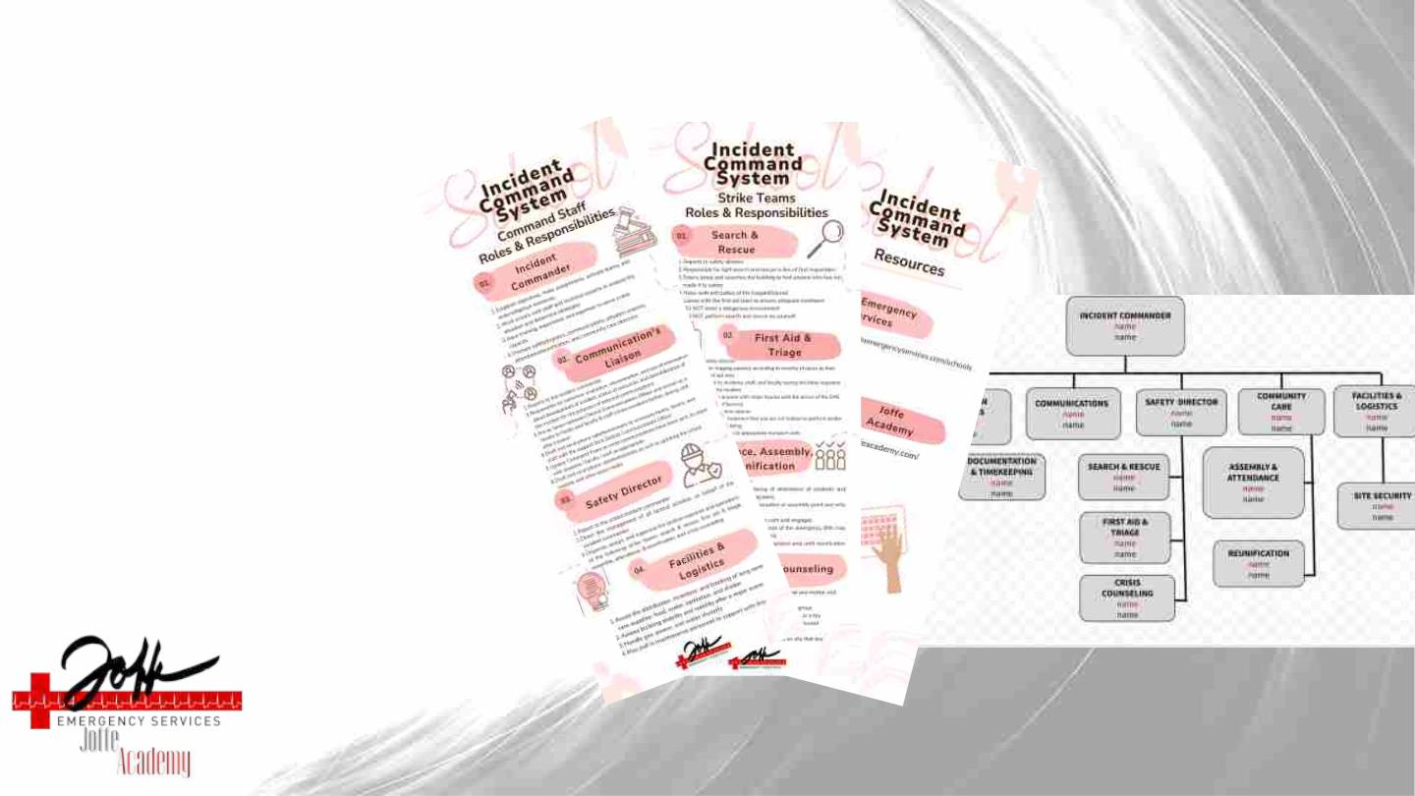
Next Steps
➢ Download
Handout &
Org Chart

