Slide 1
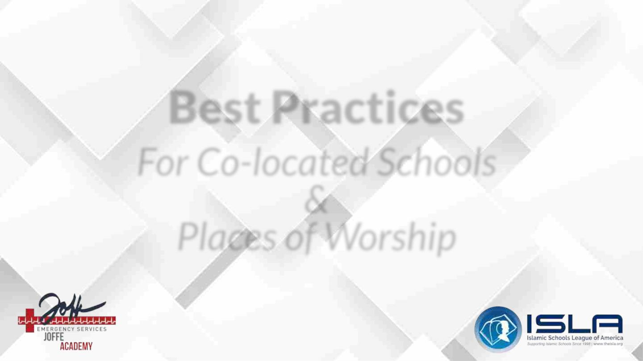
Best Practices
For Co-located Schools
&
Places of Worship

Slide 2

By the end of this module, participants will be able to:
1. Identify major threats to safety that may be due to the co-
location of the school with the place of worship
2. Assess the physical safety of the school/place of worship
3. Understand 2-3 methods of reducing risk

Slide 3

Overview of Module Sections:
1. Philosophical Considerations for Co-located Campus
Safety
2. Joffe Best Practices
3. Example Considerations for Schools Co-Located with
Mosques (Presented by ISLA Representative)

Slide 4

Framing
● Safety for staff and students is a top priority for schools.
● When a school is co-located with a place of worship,
there is an elevation of safety considerations.
● This module, which is in partnership with ISLA, the
Islamic Schools League of America, will share Joffe’s
best practices for co-located schools and places of
worship.

Slide 5

Philosophical Considerations
For Co-located
Campus Safety

Slide 6

Hours
● Schools have specific hours of operation
● Places of worship could have an “open door” at all hours

Slide 7

Shared Spaces
● Shared parking lots
● Multiple entries and exits
● School drop off/pick up times
● Schools may use specific areas for events
○ Shar

Slide 8

Specific Events
● Guests welcome at certain times for an event
● Weekend events
● Diverse communities

Slide 9

Anonymity
● Places of worship can offer anonymous atmospheres
● Schools should have continuous visuals of all areas of the campus
● Schools should have specific guest check-ins

Slide 10

Protests
● Roads are public property
● Protests can cause stress

Slide 11

Shared Staff
● School staff members could also attend the place of worship
● Sometimes, students and staff could even attend an event together at a place of worship

Slide 12

Example Considerations
For Schools Co-located
with Mosques
Presented by

Slide 13

Unique Content
● Muslim Prayers
○ Five Daily Prayers:
■ Dawn
■ Early Afternoon
■ Late Afternoon
■ After Sunset
■ Twilight
○ Friday sermon + prayer

Slide 14

Unique Content
● Mosque “Open Doors”
○ Shared premises: Co-located with school, community center,
prayer hall
○ Campus gate unlocked
○ Code widely known
○ Security Guards familiar with what “typical congregants” look
like
○ Mosque + School = Shared doors

Slide 15

Unique Content
● Events and Visitors “Open Doors”
○ Community Events held on school / mosque facilities
○ Private events held at facility
○ Parent and community events held during school hours
○ Community visitors, guests, contractors, volunteers during school hours
○ Typical security procedures may be waived or not provided
○ Facility staff assigned to events and/or visitors may not be aware

Slide 16

Unique Content
●
School “Open Doors”
○
○
○
○
○
○
Entry wide open at drop-off / pick-up
Access in to classrooms unfettered to allow parents to assist students to classrooms
Multiple buildings on campus
No centralized, monitored point of entry/exit for all parents/students
Security system / guards do not restrict parent access
Classroom, hallway doors propped open
Ventilation, easy access to shared teaching staff, easy observation by school leaders
Stairwell doors propped open / unlocked
■
○
■
■
Ease of access to students at recess and break times
Classes with one teacher can not guide students + equipment while opening/closing
doors
○
Mosque + School = Shared doors

Slide 17

Unique Content
● Parent and Community Member “Lack of Buy-in”
○ Nothing bad will happen in a religious space
○ Bad things do not happen to observant Muslims
○ I am special, just let me …
○ My kid is special, just let him/her …
○ Muslims don’t do bad things

Slide 18

Unique Content
●
Diverse Community
○
Diverse community congregants
Variety of ethnic and linguistic backgrounds
Large immigrant population
■
○
■
■
Different cultural norms and expectations
No history of safety precautions or following rules
○
Imams, School Leaders, Staff
■
■
■
Lack of training in safety procedures
Lack of awareness in need for safety procedures
Emergency guidelines and exit routes not shared with visiting speakers

Slide 19

Unique Content
●
Emergency procedures- Issues
○
○
○
Not Posted for public to see
Not discussed with community leaders and/or congregants
Emergency Response Team (if existing) limited to school leaders
■
Need for representatives from ALL stakeholders
○
○
○
Not reviewed / updated on a regular basis
Need to involve leaders from entire community
Knowledgeable facility rep to be on-campus at all times
■
■
■
Contact procedures for off-campus emergency response team to be communicated
Digital and analog communications developed
Emergency guidelines available to off-site designated team members

Slide 20

Unique Content
●
Emergency Procedures- Solutions
○
○
○
○
Post Procedures in Common Areas
Post Exit Routes in Common Areas
Provide Emergency guidelines to visiting speakers
Emergency Response Team
Consists of Reps from All Stakeholders
Facility Rep On-campus at all times
Basic security guidelines communicated
■
○
■
○
○
Review and update procedures regularly
Provide training and communication to all congregants and key stakeholders

Slide 21

Unique Content
● Governance
○ Governance of school + mosque intertwined, not
differentiated, or dysfunctional
○ Partial buy-in
○ Mosque leadership uncooperative

Slide 22

Unique Content
● Islamophobia
○ Fear, distrust and hatred of Muslims common
○ Heightened during times of political turmoil
○ Threats against congregants, mosque leader
○ Xenophobia and racism added layers

Slide 23

Crisis Scenarios
●
Mosque:
○
Guest imam does not know or follow emergency protocol:
■
Fire alarm goes off during last portion of the sermon; imam tells everyone
to stay put
■
■
■
Exit doors closed / covered
No safe gathering space for congregants outside the building
Parking Spots Blocked- Emergency vehicle entry blocked
○
Gate to mosque open during Friday prayers so guests can arrive, delays caused
by gate closures/opening minimized

Slide 24

Crisis Scenarios
● School
○ Belligerent spouse/ex-spouse of a staff (parent of a student)
comes on campus
○ Understaffed schools

Slide 25

Crisis Scenarios
●
Mosque
○
Fire Alarm during Religious Service:
■
■
Fire alarm goes off - Imam tells everyone to stay put
Exit doors closed / covered preventing exit
○
Earthquake during Religious Service
■
■
■
Imam continues prayer
Unattached objects fall all on congregants
No furniture available to shield congregation from broken glass, falling
light fixtures
■
■
Shoes removed to pray in carpeted hall - feet cut from items on ground
Mosque personnel may not be present to turn off gas, check building for
structural damage
■
No registry of emergency contacts + medical alerts for attendees and
family members at prayer

Slide 26

Joffe
Best Practices

Slide 27

Physical Security
● Parking
● Appropriate lighting
● Monitored entry
○ Visitor logs. Sign in/sign out
○ Clear signage for locations
○ Instructions for guests to sign in
○ Visitor identity/ destination verification
○ Employee on campus attendance system
○ Student early dismissal/sign out system

Slide 28

Physical Security
● Campus perimeter fencing
● Lockable doors
● Program development: written protocols
○ Evaluate current protocols
○ Construct new policies when applicable

Slide 29

Supplies/Systems/Tools
● Security cameras
● Alarm systems onsite
● Fire extinguishers
● AEDs (locations & amount)
● Lockdown kits

Slide 30

Communication
● Threat response
● Anonymous reporting
● Social media threat monitoring
● Signage differentiating the locations of the school and the place of worship
● Ability to initiate school-wide & house of worship-wide messaging
● Panic button
● Communication postings
○ Evacuation maps
○ protocols/procedures at a glance

Slide 31

Personnel
● Health coordinators or shared health personnel
● Security guards

Slide 32

Develop Security Plans
● Emergency Operations Plan
○ 4 emergency responses
■ Lockdown
■ Shelter in place
■ Secure campus
■ Evacuation plans

Slide 33
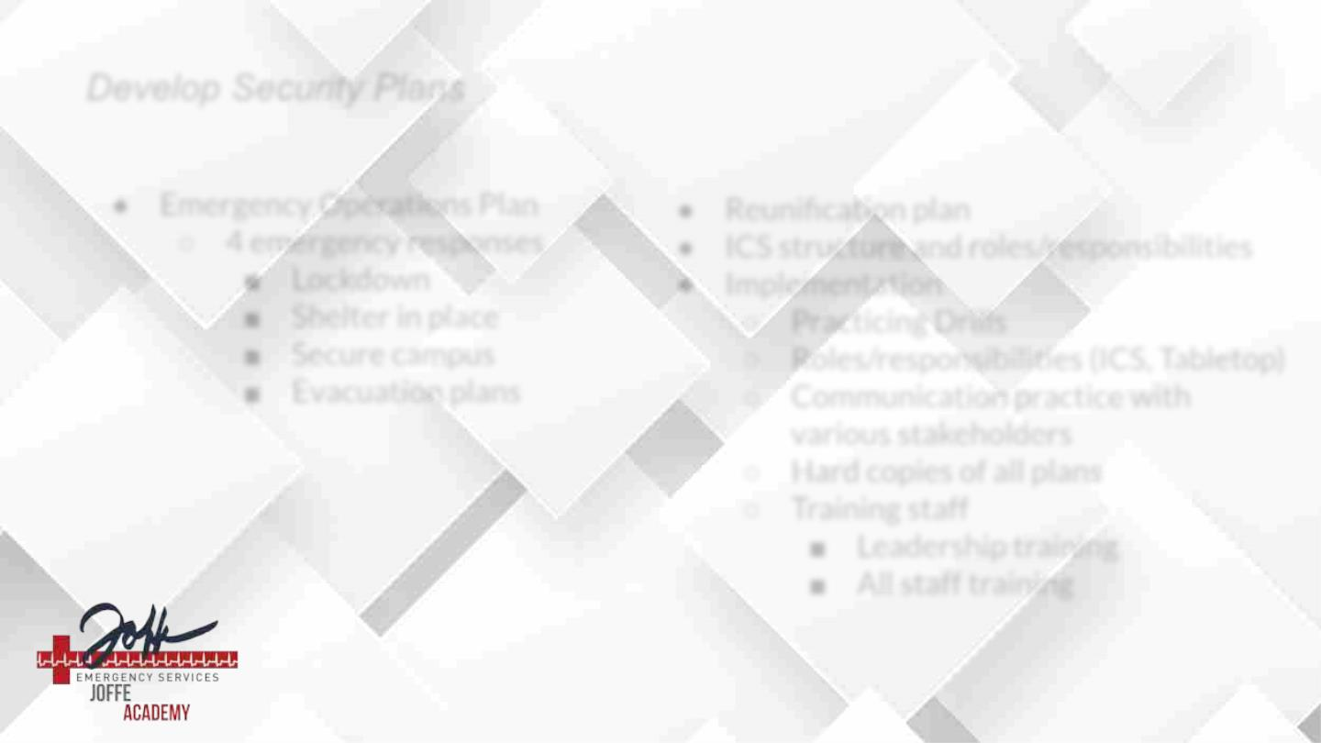
Develop Security Plans
● Emergency Operations Plan
○ 4 emergency responses
■ Lockdown
● Reunification plan
● ICS structure and roles/responsibilities
● Implementation
■ Shelter in place
■ Secure campus
■ Evacuation plans
○ Practicing Drills
○ Roles/responsibilities (ICS, Tabletop)
○ Communication practice with
various stakeholders
○ Hard copies of all plans
○ Training staff
■ Leadership training
■ All staff training

Slide 34

Joffe Academy Modules
● An Introduction to an Emergency Operations Plan (EOP)
● Incident Command Structure Trilogy
● ICS (Part 1): Incident Command Orientation
● ICS (Part 2): How to Create and Run a Tabletop
● ICS (Part 3): Student and Family Reunification

Slide 35

Closing
● Crisis Communication Planning Module
● School Safety Assessments & Consultative
Services
○ www.joffeemergencyservices.com
● Module Handouts

